Slide 1


Public Health
Awareness Campaign
Lets get started with our presentation on the Public Health Awareness Campaign. In this campaign, we aim to raise awareness and educate the public about various important health issues. And Examine the success of future camapigns based on the analysis of mental health prediction dataset. Come on Let's dive in and explore the contents and topics covered in this presentation.

Slide 2
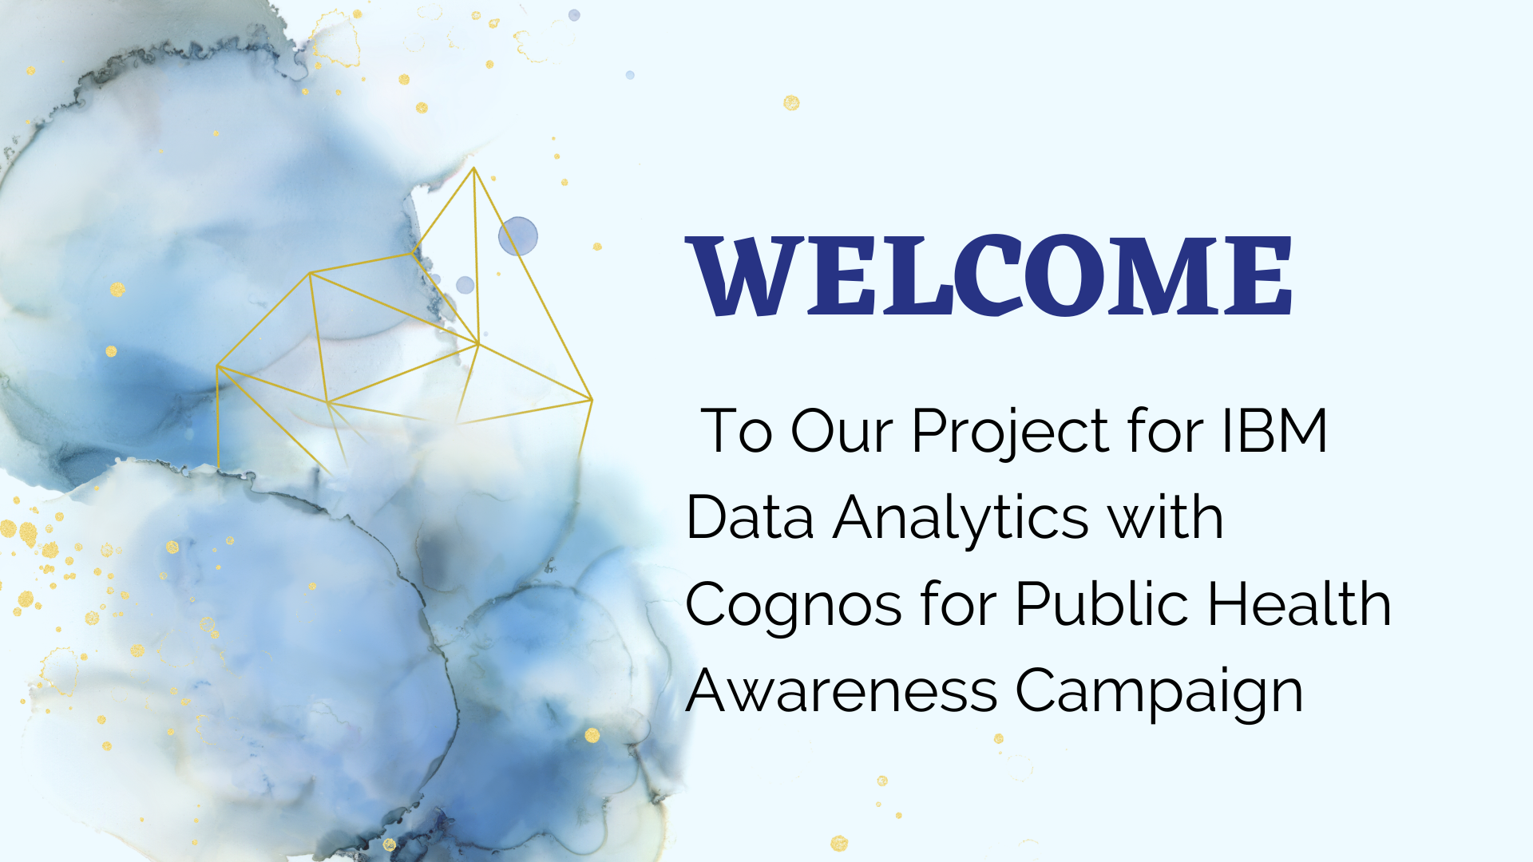

Slide 3
Data Extraction in Notebook
1
Web Scraping
Explore web scraping techniques to extract relevant data for our campaign from various online sources.
2
API Integration
Learn how to integrate APIs to fetch real-time data and make our campaign more informative and up-to-date.
3
Data Cleaning and Preprocessing
Understand the importance of data cleaning and preprocessing to ensure the accuracy and reliability of the extracted data.

Slide 4

Ways to implement Machine Learning Algorithms to predict the success of future campaigns based on historical data of mental health prediction dataset.

Slide 5
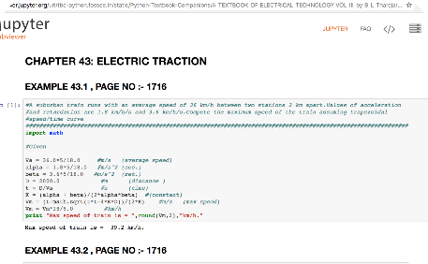

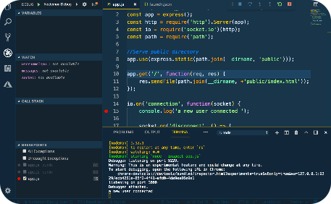
Jupyter Notebook Code Implementation
Introduction to Jupyter Notebook
Coding in Jupyter
Notebook
Debugging Techniques
Understand the basics of coding in Jupyter Notebook to effectively execute our campaign tasks.
Discover useful debugging techniques to troubleshoot any issues encountered during the code implementation process.
Learn how to set up and navigate Jupyter Notebook for implementing our campaign strategies.

Slide 6
Procedure
Jupyter Notebook Code Implementation
Data Extraction in Notebook
Machine Learning Algorithms
Get hands-on experience with Jupyter Notebook to implement different aspects of the campaign.
Learn how to effectively extract data using Jupyter Notebook for our campaign.
Discover the power of machine learning algorithms like Random Forest, K Classifier, CNN, KNN, and Gradient Descent for enhancing our campaign.

Slide 7


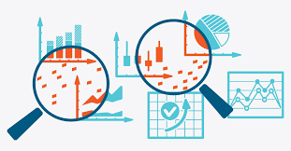
Data Collection and Preparation:
Gather historical data on past campaigns. This data should include various features like campaign type, target audience, messaging, channels used, timing, and the outcome (e.g., conversion rate, ROI).
Clean and preprocess the data to handle missing values, outliers, and ensure data consistency.

Slide 8

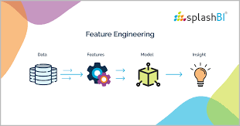
Feature
Engineering:
Create relevant features from the raw data that can help the machine learning model make accurate predictions. For example, you might create features like day of the week, seasonality, or customer segmentation based on demographics.

Slide 9

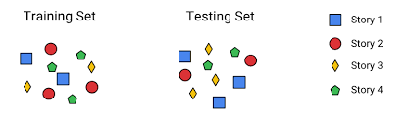
Data Splitting:
Split your dataset into training, validation, and test sets. The training set is used to train the machine learning model, the validation set is used to tune hyperparameters and evaluate model performance during development, and the test set is reserved for final model evaluation.

Slide 10

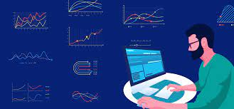
Model Selection:
Choose an appropriate machine learning algorithm for your prediction task. Common algorithms for classification and regression tasks include decision trees, random forests, logistic regression, gradient boosting, and neural networks.

Slide 11

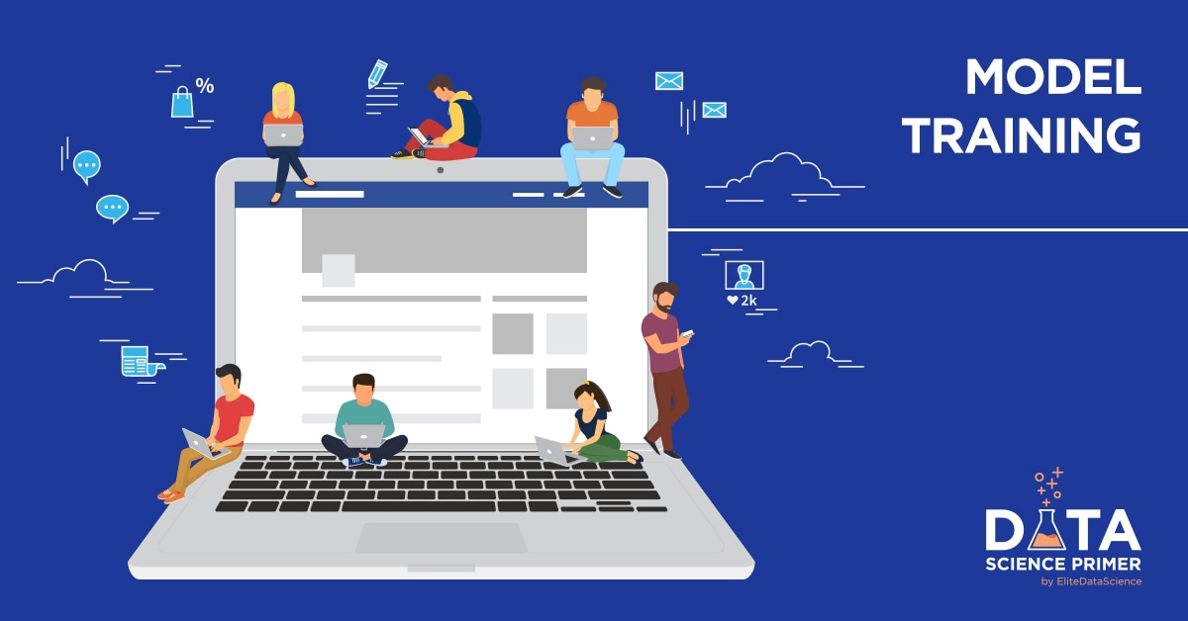
Model Training:
Train your selected machine learning model on the training data using appropriate hyperparameters. Fine-tune the model to achieve the best performance on the validation set. This process may involve cross-validation and hyperparameter tuning.

Slide 12


Evaluation Metrics :
Select appropriate evaluation metrics for your campaign prediction task. Common metrics include accuracy, precision, recall, F1-score, mean absolute error (MAE), mean squared error (MSE), or root mean squared error (RMSE).

Slide 13

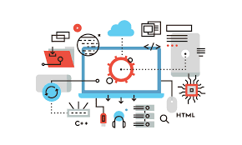
Monitoring and
Maintenance:
Continuously monitor the model's performance in a production environment and retrain it periodically with new data to keep it up to date.

Slide 14

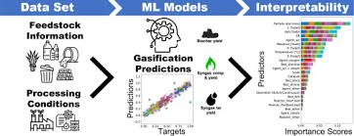
Model Interpretability:
Depending on the algorithm chosen, consider methods for interpreting the model's predictions. This is important for understanding which factors are driving campaign success predictionDeployment:
Once you have a trained and validated model, deploy it into your operational environment. This could involve integrating it into your campaign management software or using it to make predictions through an API.

Slide 15


Feedback Loop:
Collect feedback on the model's predictions and incorporate this feedback into future campaigns. This iterative process can help improve the accuracy of your predictions over time.

Slide 16
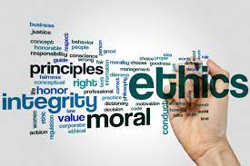
Ethical Considerations:
Ensure that your predictive model is developed and deployed in an ethical manner, considering issues like bias, fairness, and privacy.
Remember that the success of your machine learning model depends not only on the algorithm but also on the quality of the data, feature engineering, and domain knowledge. Regularly reevaluating and updating your model is crucial to maintain its predictive accuracy as market dynamics change.
Additionally, it's advisable to work with data scientists or machine learning experts to implement and maintain such predictive models effectively.

Slide 17
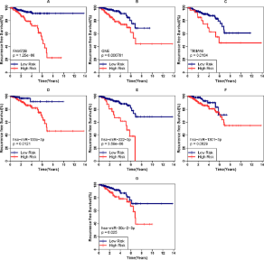

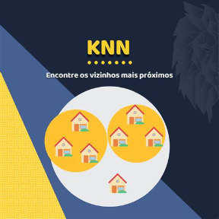
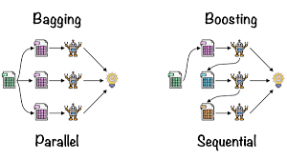
Machine Learning Algorithms
Random Forest
K Classifier
CNN (Convolutional Neural Network)
KNN (K-Nearest Neighbors)
Explore the Random Forest algorithm and its application in predicting health trends and outcomes.
Dive into the K Classifier algorithm and understand its role in analyzing health-related data for our campaign.
Learn how the KNN algorithm can be utilized to identify patterns and make predictions in public health data.
Discover the power of CNN in image analysis for our campaign, focusing on health-related images.

Slide 18

Machine learning Code Implementation for prediction of success rate in future

Slide 19
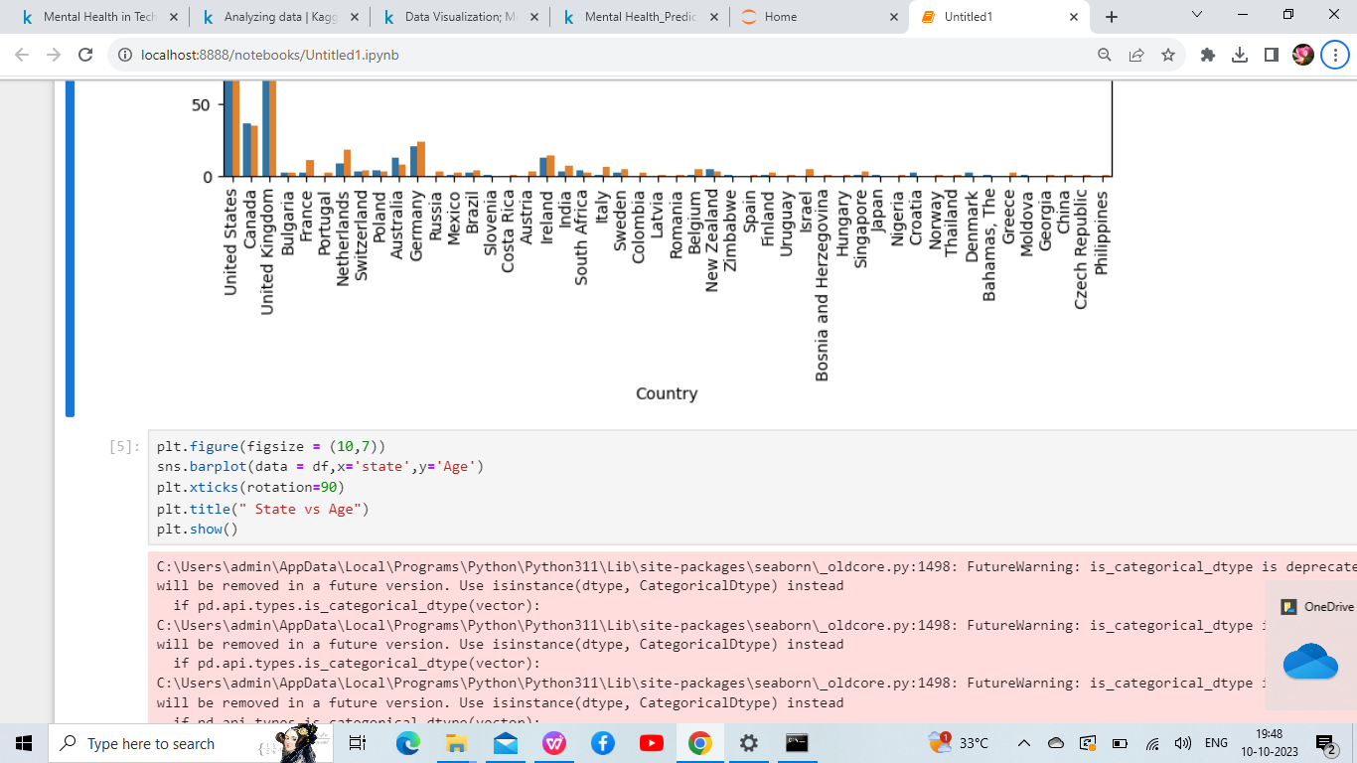
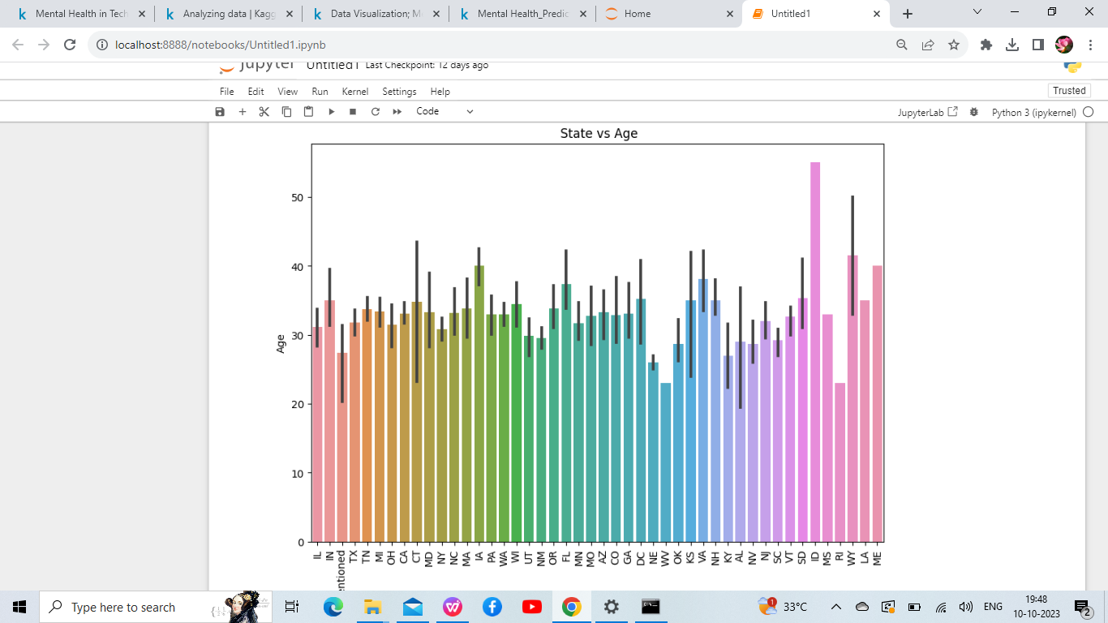
State Vs Age

Slide 20
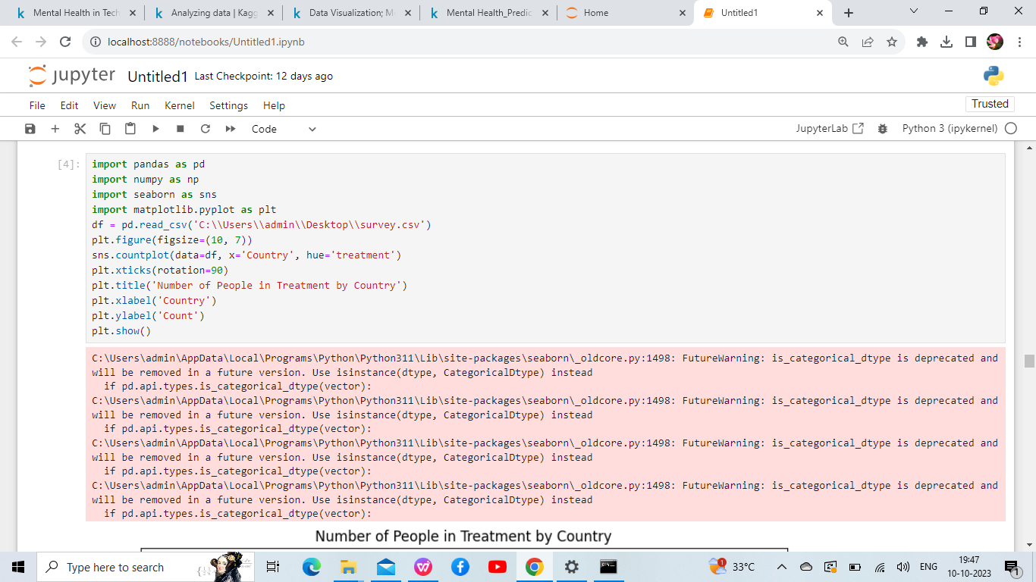
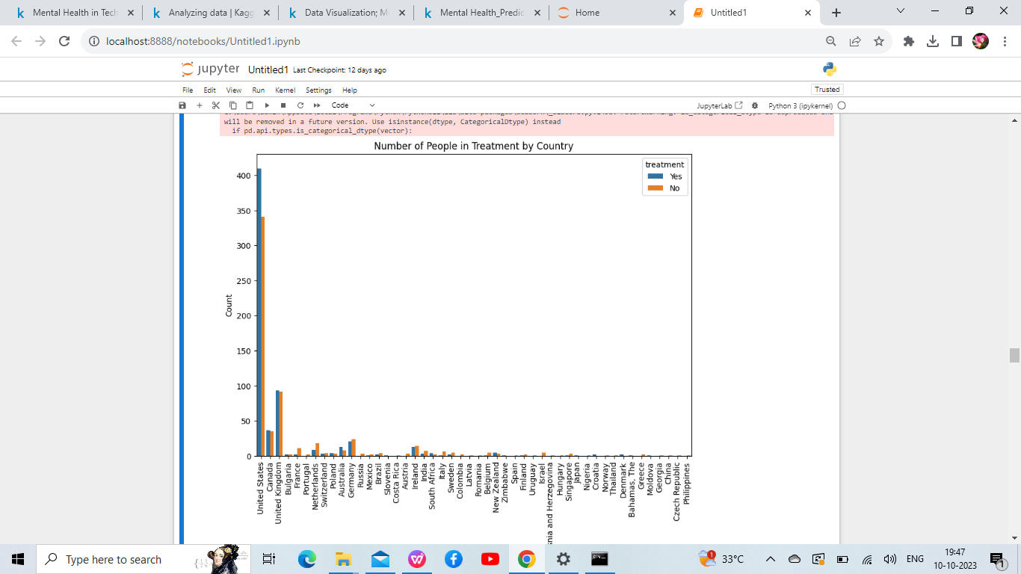
h
Number of people in Treatment by Country country

Slide 21
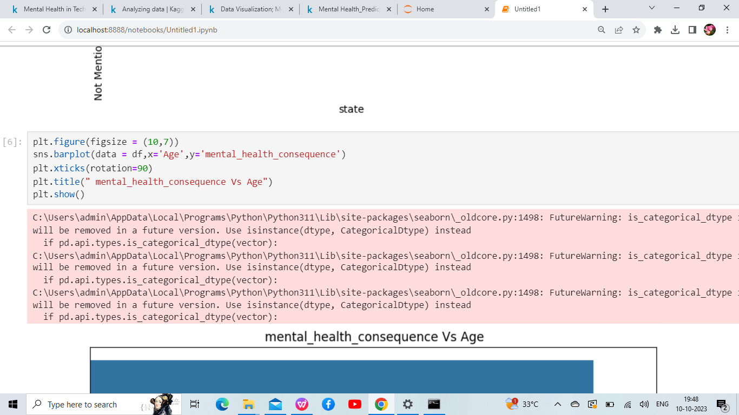
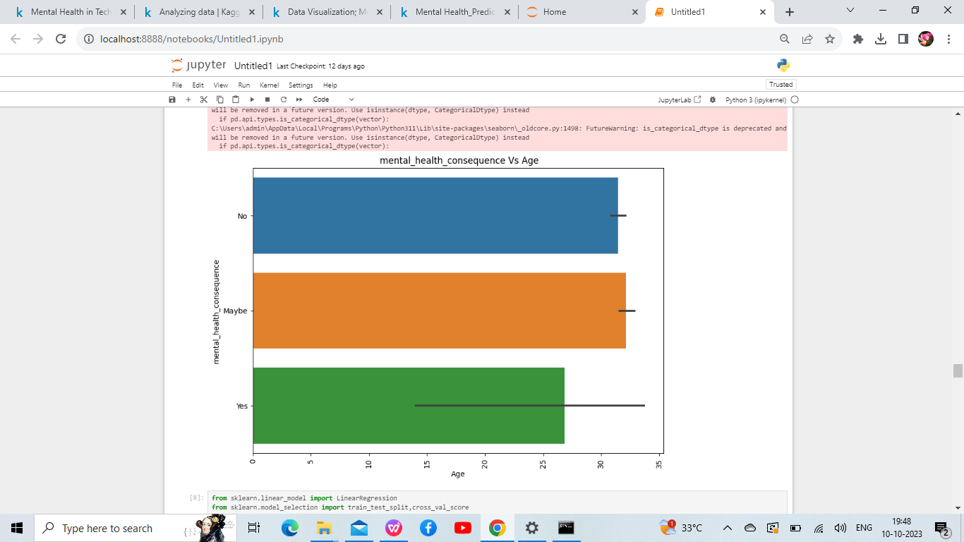
h
Mental health consequences Vs Age

Slide 22
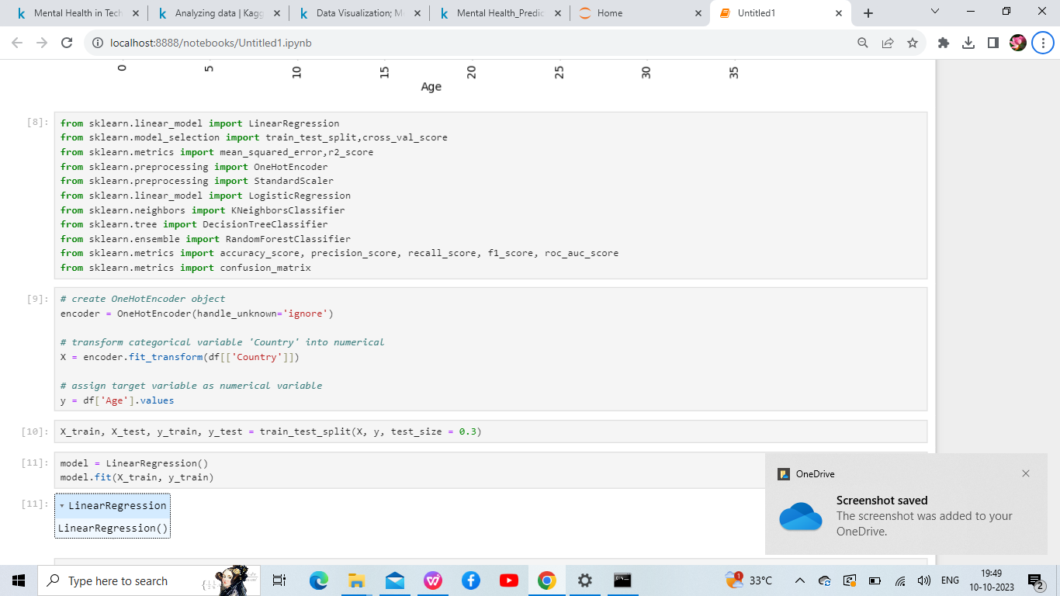
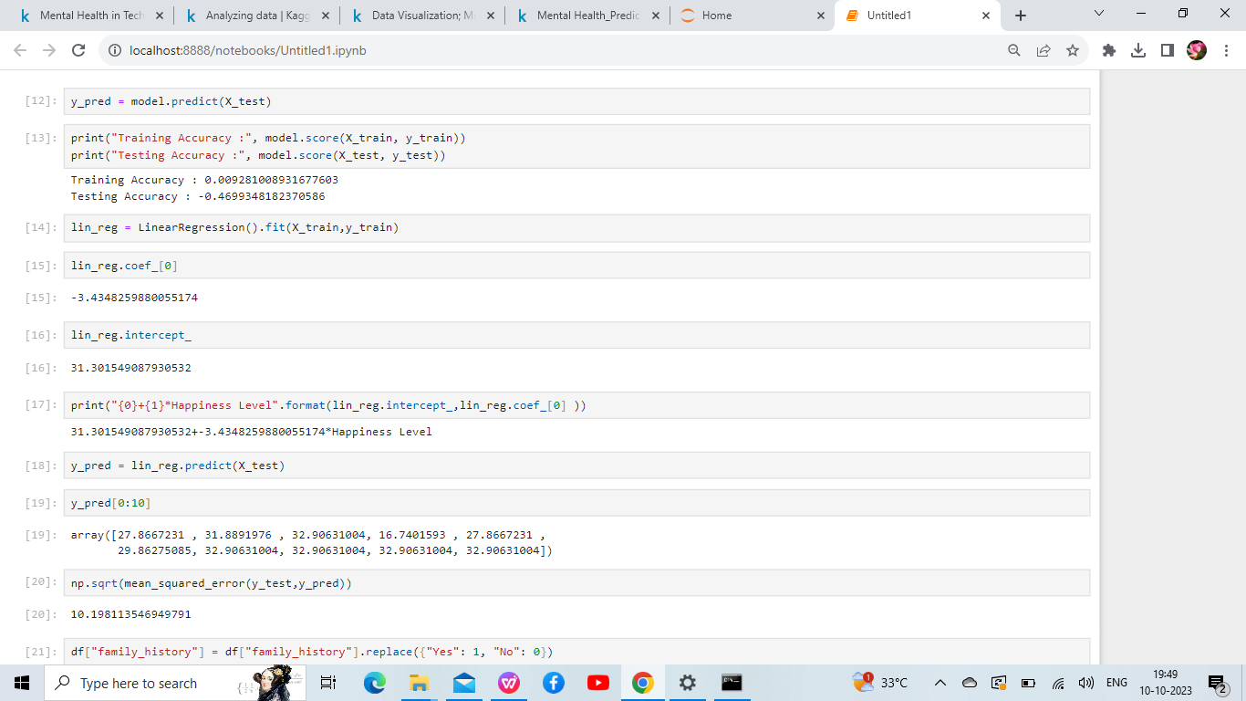
h
Linear Regression Algorithm

Slide 23
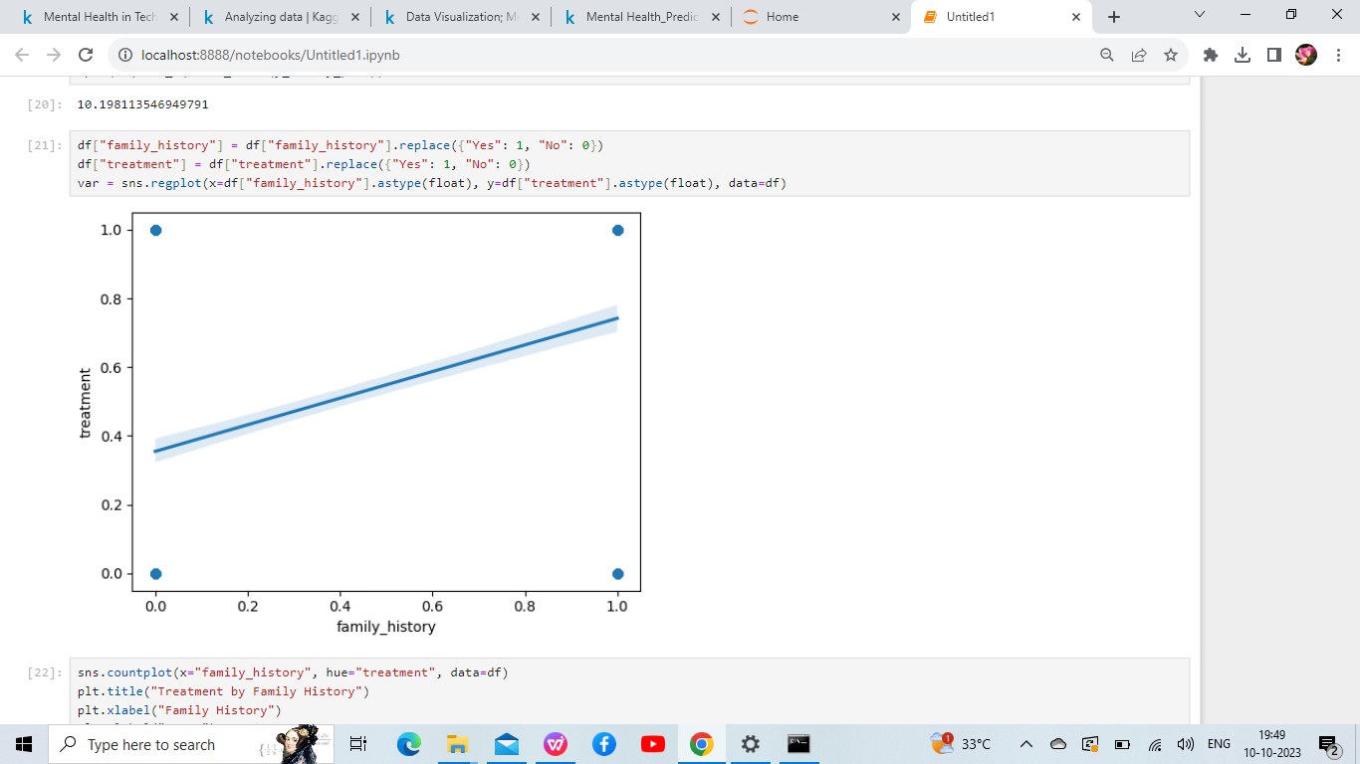
h
Treatment with family history

Slide 24
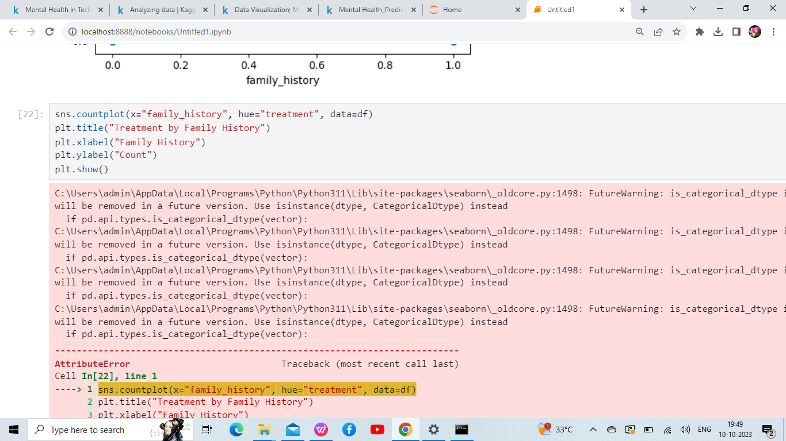
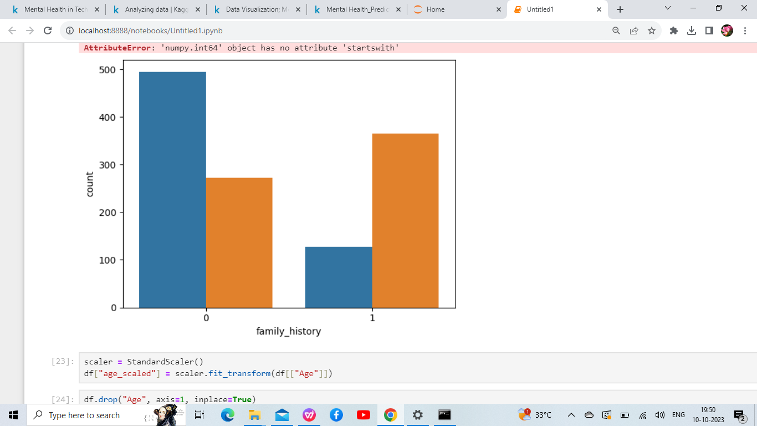
h
How is the treatment By family history

Slide 25
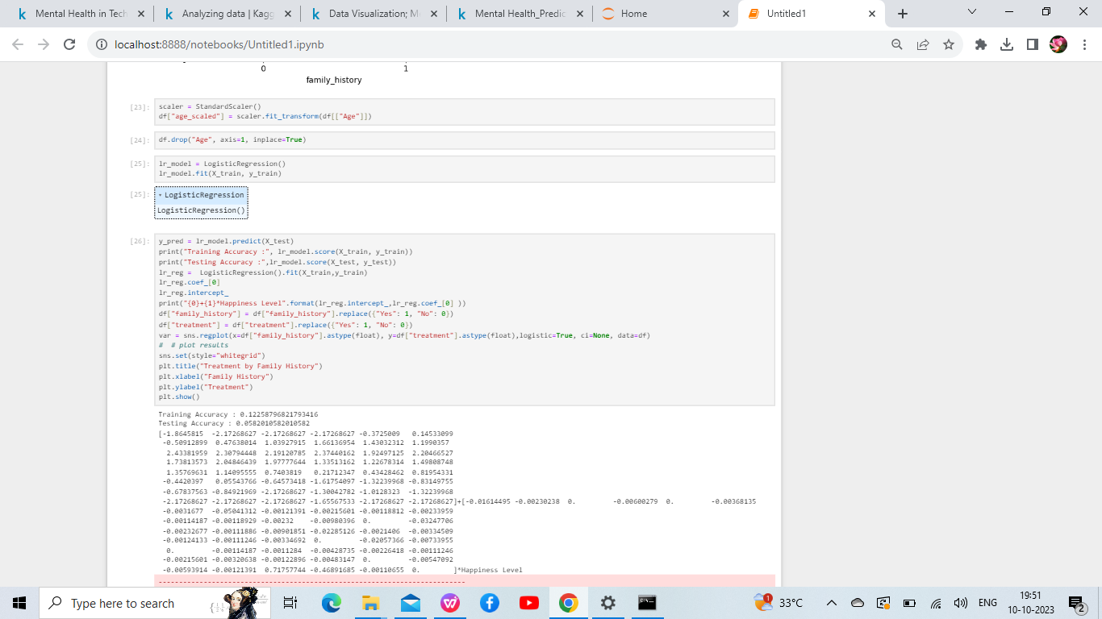
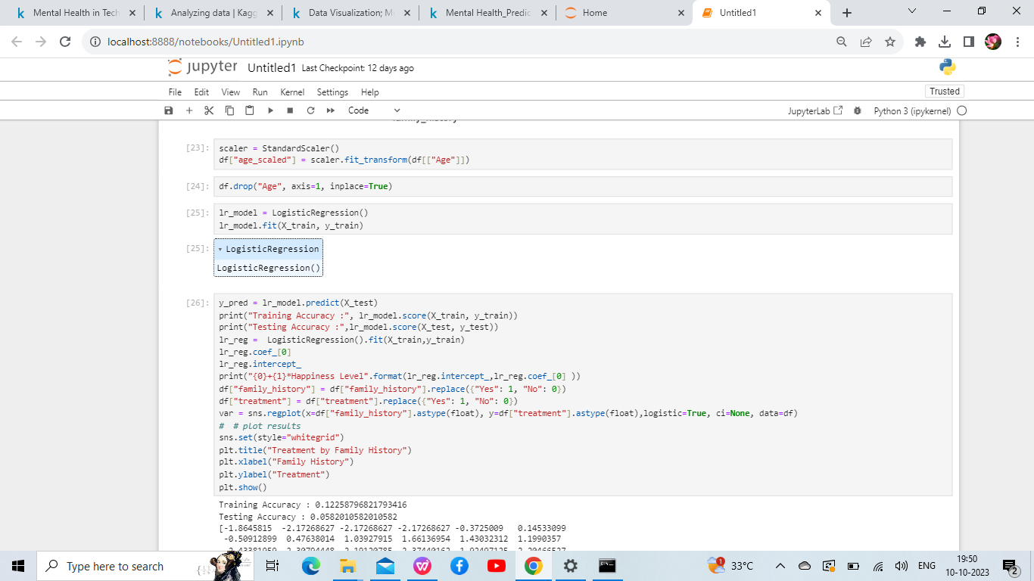
h
Training Accuracy and Testing Accuracy

Slide 26
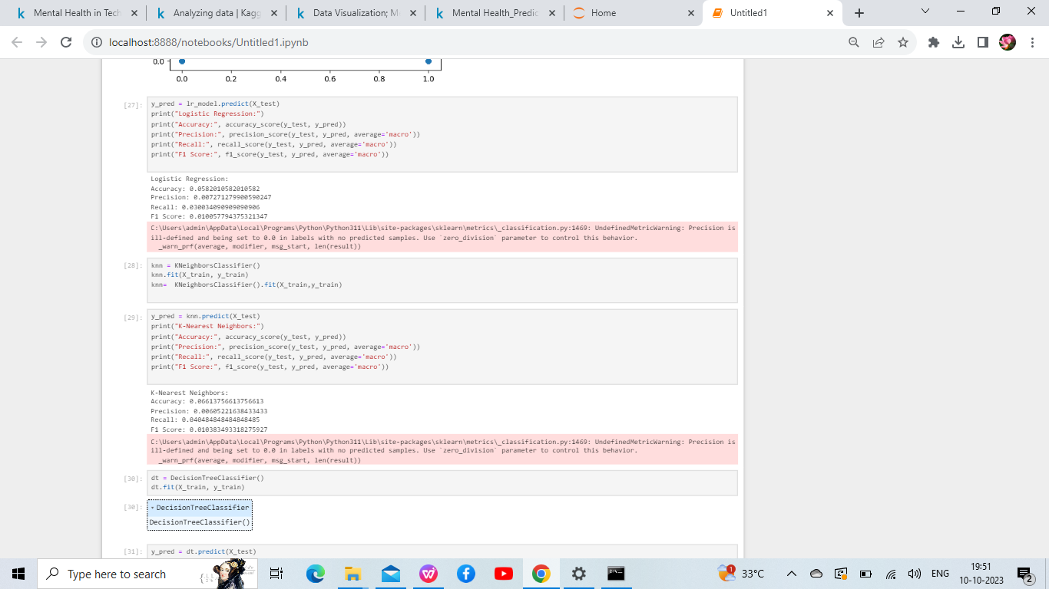
h
Logistic regression ,K Neighbour classifier,
K-nearest Neighbour and Desision tree classifier

Slide 27
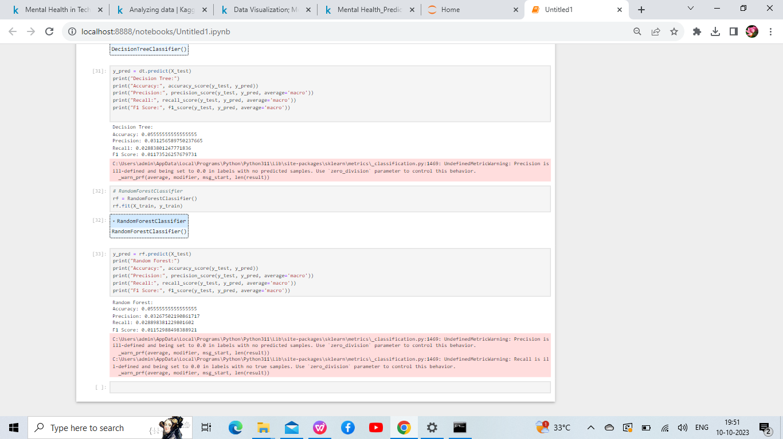
h
Decision Tree Classifier and Random Forest Classifier

Slide 28
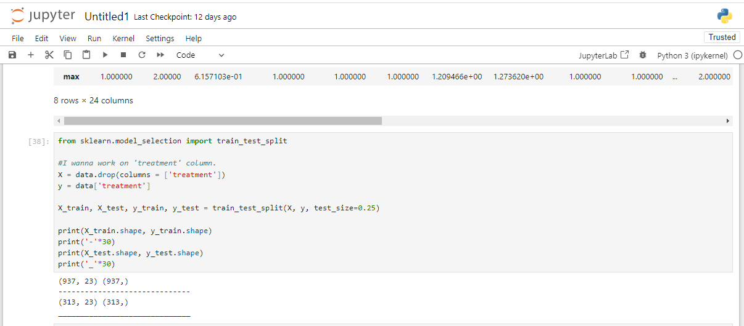
h
Test and Train Model Algorithm

Slide 29
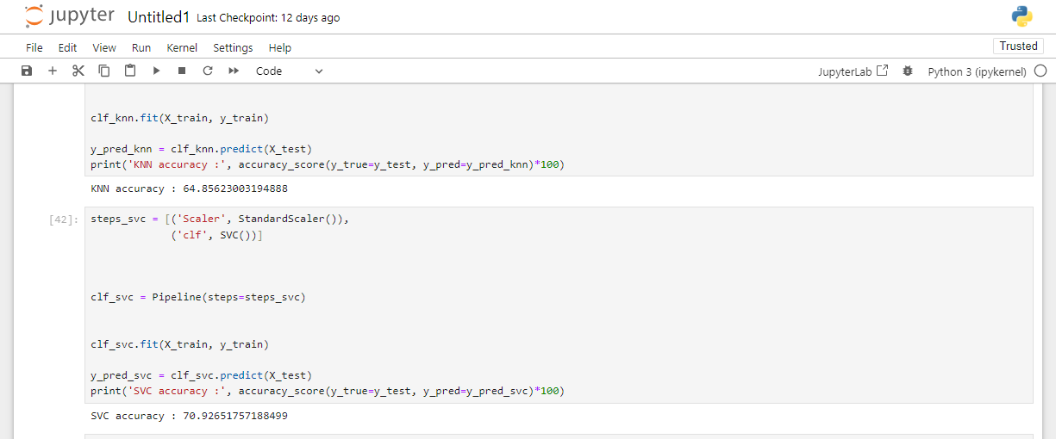
h
Support Vector Classifier Algorithm

Slide 30

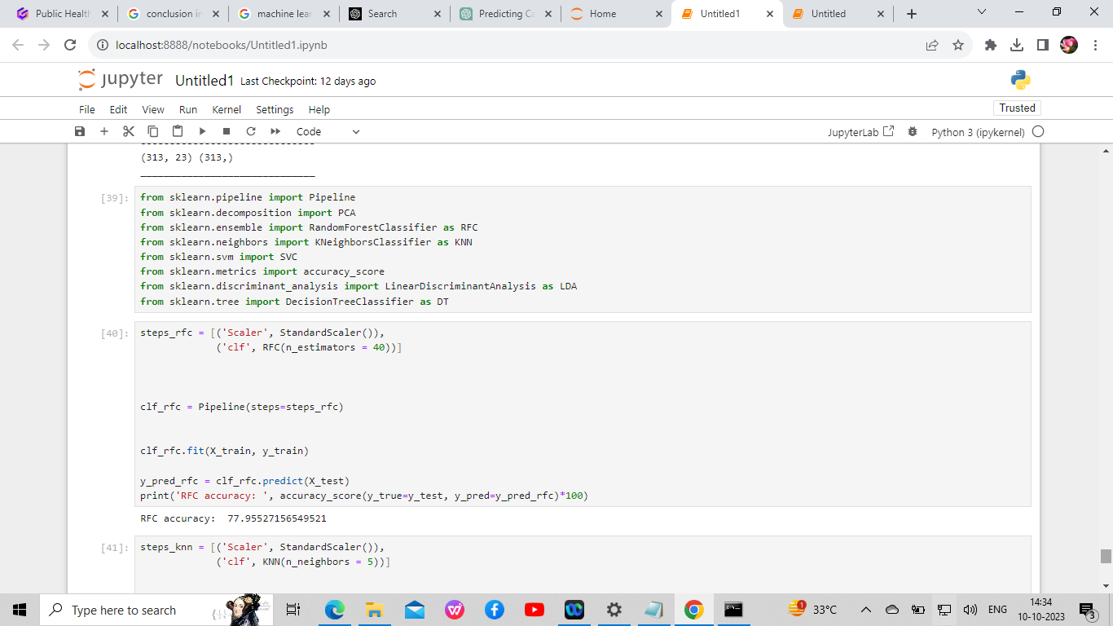
Random Forest Classifier Algorithm

Slide 31
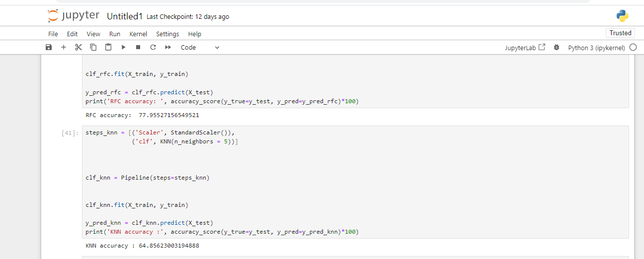
K Nearest Neighbour Algorithm

Slide 32
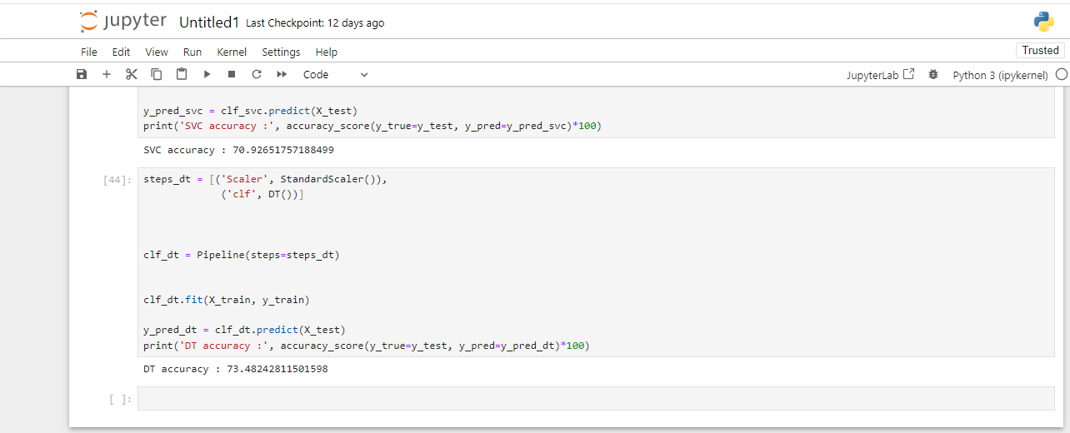
Decision Tree Algorithm

Slide 33

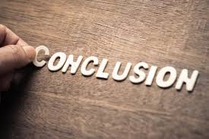
Conclusion
In conclusion, through this Public Health Awareness Campaign, we have covered a range of important topics, from Jupyter Notebook code implementation and data extraction to the utilization of various machine learning algorithms. By leveraging these technologies, we are confident in our ability to raise awareness effectively and make a positive impact on public health. Together, let's work towards a healthier future!

